Slide 1
Control System for Everything
The New and the Right Way of Building Internet of Things

Slide 2
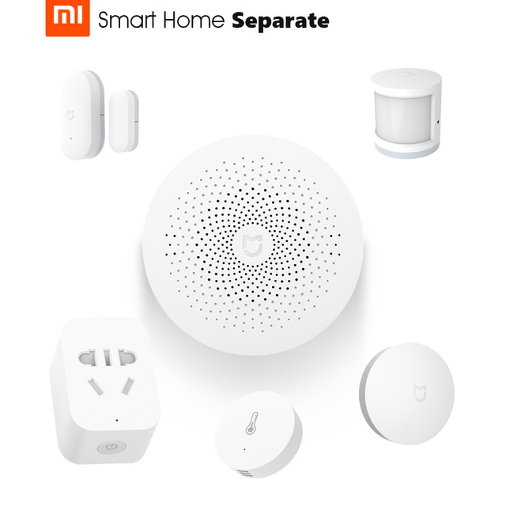
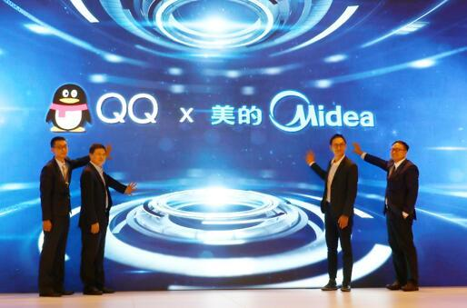
The Most Important Aspect: Interoperability
Many effort seems been put into it. But little have been achieved.
Everybody wants to dominate.
Does not means using the same protocol.

Slide 3
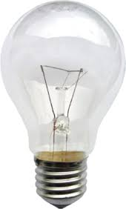
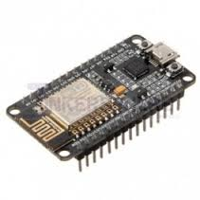
The current IoT approach is wrong
There is no good to give everything an IP address
  6Lowpan is limited and meanless
The current protocol are just lies
  MQTT is a liar: heavy, needs broker, designed to sell services
  CoAP is a joke: like RESTful by not and not compatible and not light
Implementing the above is expensive!
The most popular solution out there is nRF24L, ESP8266
$1
$15

Slide 4
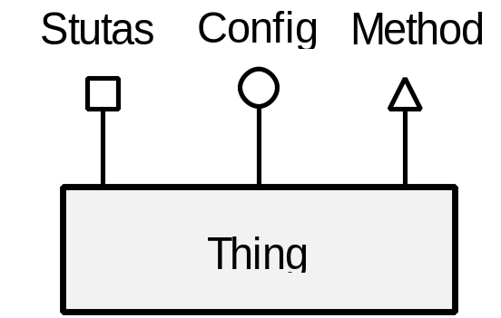
Modeling of things
Status
  Read by others changed by self,
  by looking at the statuses solely, one can determine all the output and behavior of the thing.
Configuration
  Read by self changed by others,
  Represent the desired behavior
Method
  A command
  Event handler

Slide 5
Modeling of things
Resource
  Status
  Config
  Method
  Interoperate means: Locate and access resources

Slide 6
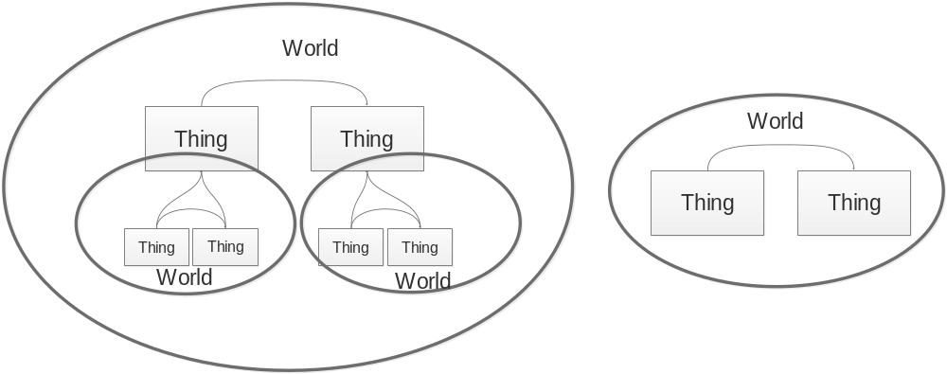
Modeling of things
World
  Unlimited interoperability is bad

Slide 7
Modeling of things
What is a thing?
  Has resources
  Can be physical or virtual
  Things can aggregate into bigger things

Slide 8
Dumb and Smart Things
Cost!!!!
Dumb thing is god damn cheap!!!
But still interoperable
How?

Slide 9
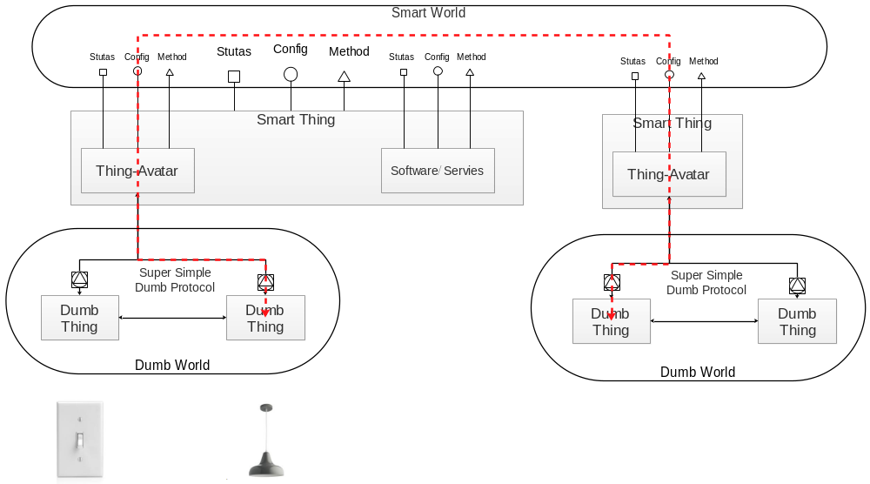
Dumb and Smart Things

Slide 10
Dumb Protocol Pattern
Language
Identity
Knowledge
Existing protocol can be parsed in the above way

Slide 11
Dumb Protocol Pattern
Bindings:
  Static:
    The avatar it preconfigure and knows the identity of the dumb things, and have the knowledge of the resource on the dumb things.
  Interactive
    The avatar is not preconfigured. But when the dumb thing request a bind the avatar is created and the smart device can be recognized the dumb device and then establish the knowledge from pre-configurations or looking up a knowledge base but not from the dumb thing.
  Dynamic
    The avatar is not preconfigured. When the dumb thing request a bind the avatar the avatar is created and the smart device cannot be recognized. The smart thing cannot establish the knowledge base. It then negotiate with the dumb thing to establish the knowledge.

Slide 12
Web of things
Already lots of things connected to the internet but interoperability is not achieved
But the web is an exception
The fundamental of web is HTTP and HTML. We will leverage on these.
Web is also in massive scale

Slide 13
Web of things
RESTful
  Resource located by URI.
  Access indicated by verb
  Hypermedia!!!
    Using JSON-LD
    Embrace the semantic web
HTML JS
  HMI auto generation

Slide 14
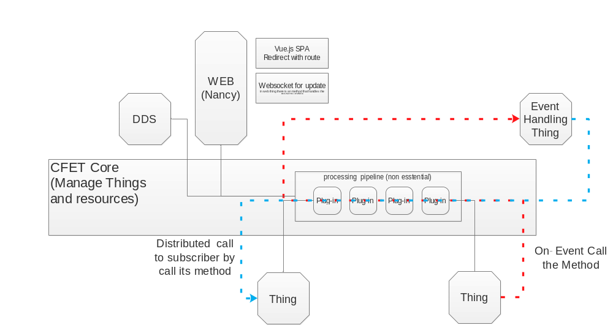
Implementation
Smart things

Slide 15

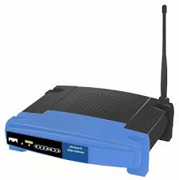
Dumb things
Extreme simple:
  nRF24L01+ Arduino (attiny85 45 24) or nRF24LE1
  Key fob remote and a RGP lamp.

Slide 16
Dumb things
All-in-one but simple:
  ESP8266 single chip sensor and actuator node
  UDP implementation of Super Simple Dumb Protocol (SSDP)
  Basic DIO + AIO + UART + SPI
  Modular software

Slide 17
Dumb things
Cheap yet powerful:
  Arduino + Communication module general sensor and actuator node
  SSDP on various media (nRF24L01, zigbee, esp8266)
  Modular and advanced DIO like relay
  AIO, SPI, UART
  We do this first

Slide 18
Market
Smart building automation
Proton therapy
HEP, Fusion experiment (kick EPICS right in the ass)
Smart Agriculture
Home automation (eventually controls everything)

Slide 19

Smart Agriculture

Slide 20
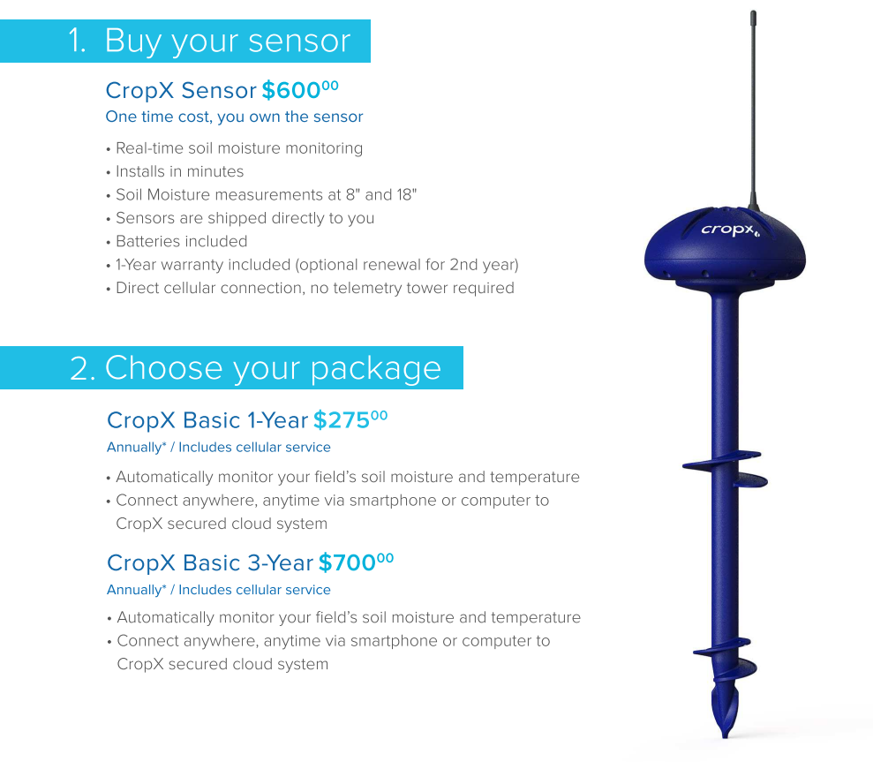
Smart Agriculture

Slide 21
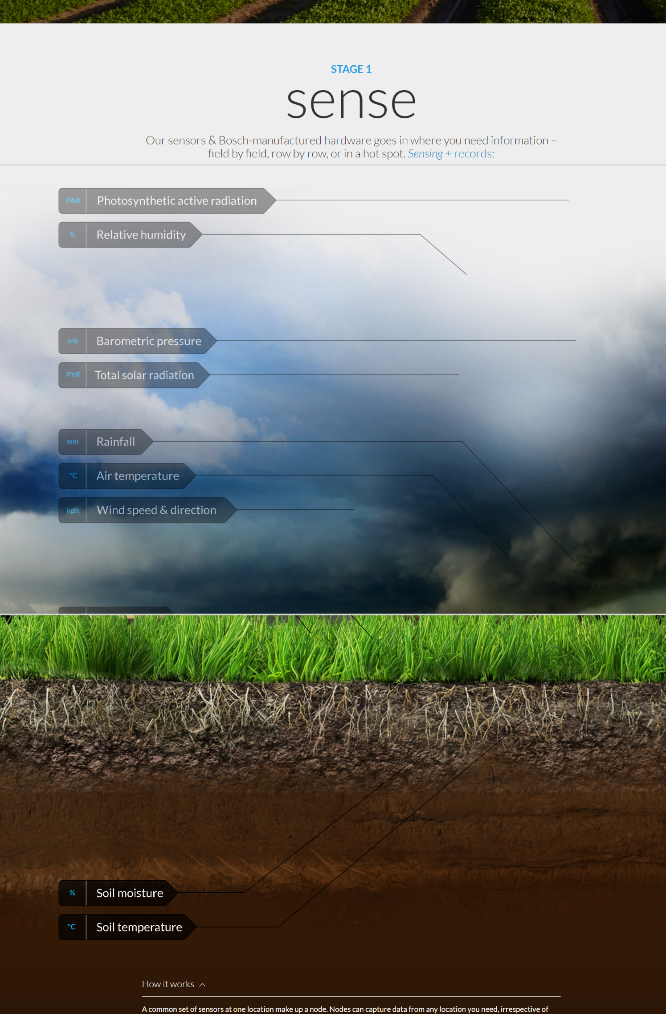
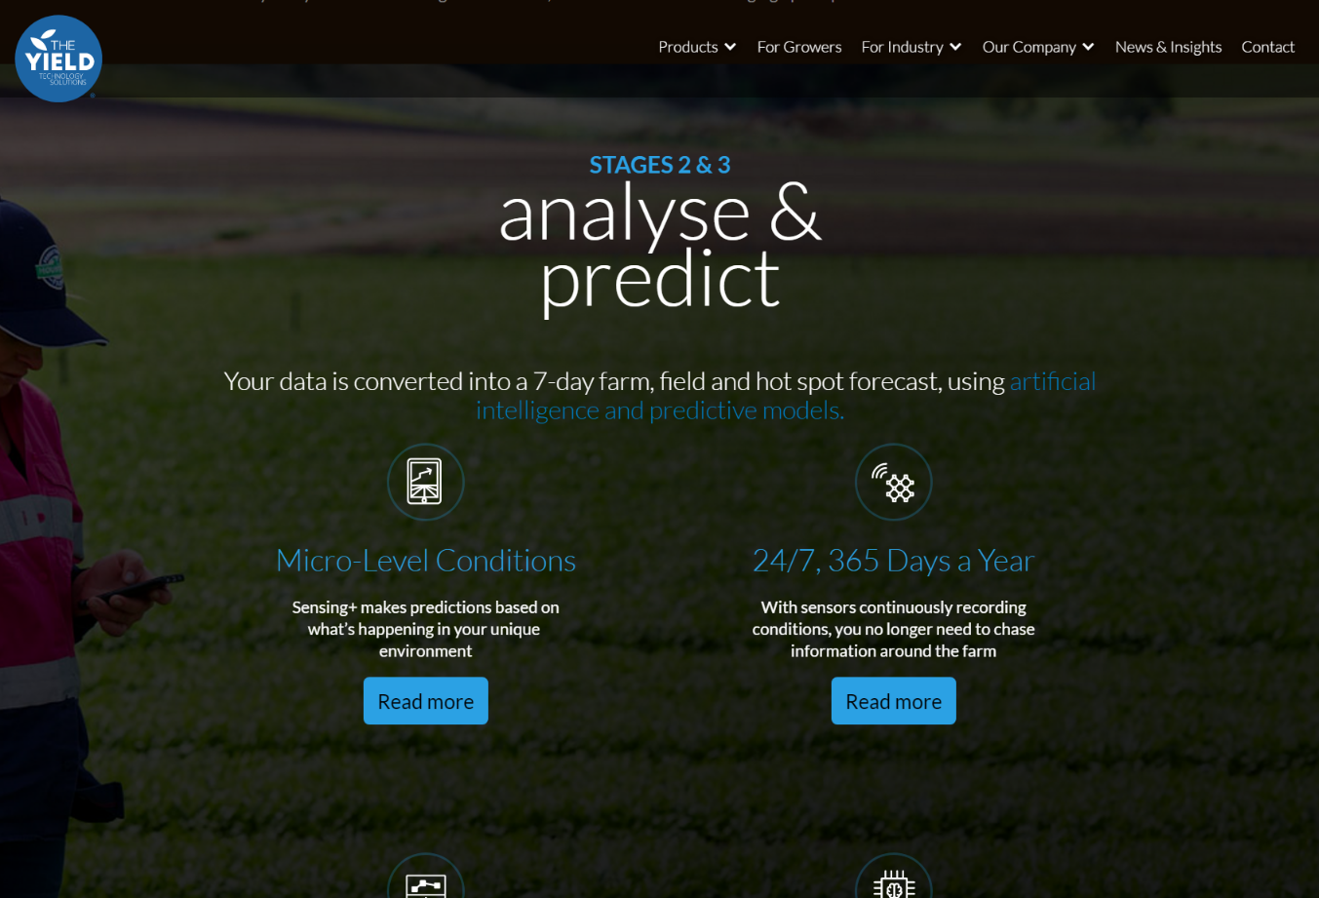
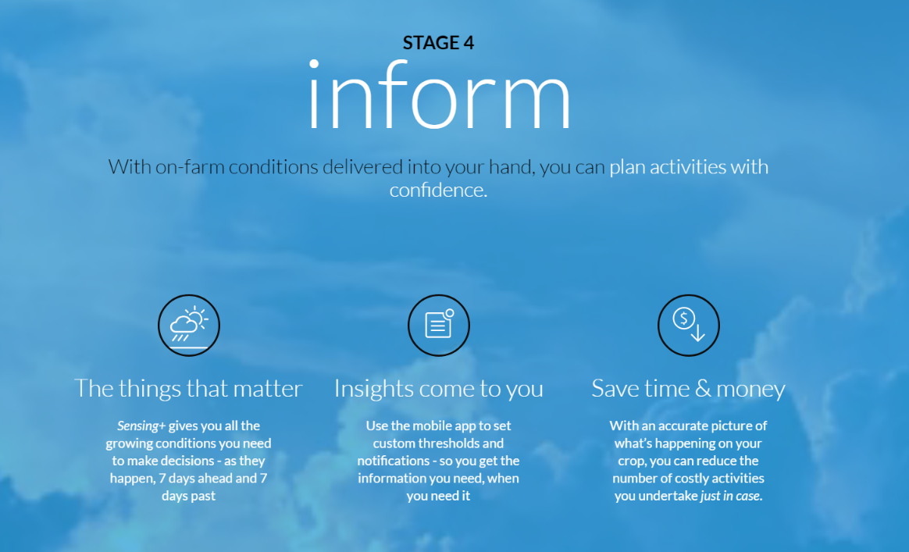
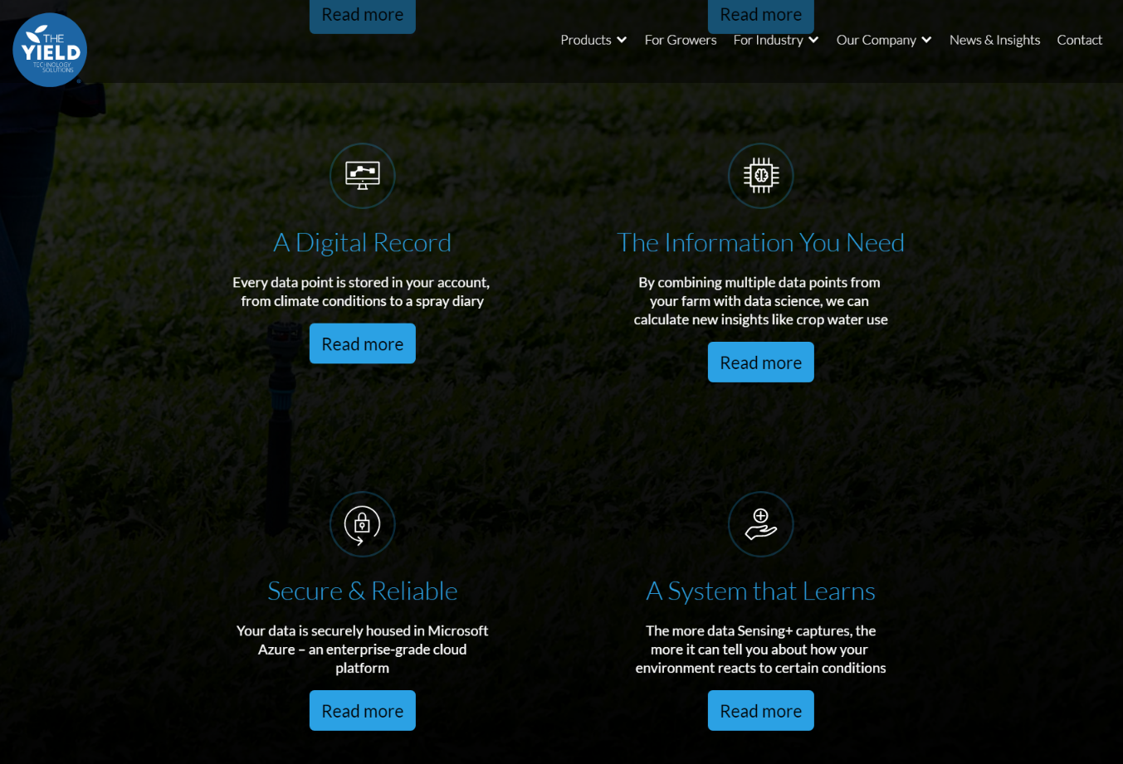

Slide 22
Agricultural Internet of Things technology applications—by IBM
Water supply management
Precision agriculture
Integrated Pest Management or Control
Food production and safety
Livestock management

Slide 23
